Slide 1




NEXT GEN EMPLOYABILITY PROGRAM
Creating a future-ready workforce
Team Members
College Name
Student Name :Reshma .D
Student ID : au960221104094
Arunachala college of engineering for women

Slide 2

CAPSTONE PROJECT SHOWCASE
Project Title
Car Rentals Application with Django Framework
Abstract | Problem Statement | Project Overview | Proposed Solution | Technology Used | Modelling & Results | Conclusion

Slide 3
ABSTRACT
The Car Rental Management System is
a crucial aspect of the transportation industry, facilitating seamless vehicle booking, management, and customer interaction. This abstract presents the development of a web-based application using the django framework, aimed at streamlining the car rental process for both rental companies and customers.
Source :

Slide 4
PROBLEM STATEMENT
The car rental industry faces various challenges in managing operations efficiently, including cumbersome booking processes, manual inventory management, and inadequate customer engagement. These inefficiencies lead to increased administrative burden, decreased customer satisfaction, and potential revenue loss. To overcome these challenges, there is a pressing need for a robust, user-friendly, and scalable car rental management system.
Source :

Slide 5
PROJECT OVERVIEW
The Car Rentals Application is a web-based platform designed to streamline the process of renting vehicles for both customers and rental companies. Built using the Django framework in Python, this application aims to provide an efficient, user-friendly, and secure solution for managing car rentals.
Source :

Slide 6
PROPOSED SOLUTION
The proposed solution aims to develop a robust and user-friendly Car Rentals Application using the Django framework in Python. This application will facilitate seamless vehicle rental operations for both customers and rental companies, offering features such as vehicle inventory management, booking processing, user authentication, and billing.
Source :

Slide 7
1. User Authentication and Authorization:
Implement user authentication and authorization mechanisms using Django's built-in authentication system.
Define different user roles such as customers, administrators, and staff members, each with specific permissions and access levels.
2. Vehicle Inventory Management:
Develop a centralized database to store information about available vehicles, including make, model, year, rental rates, and availability status.
Implement CRUD (Create, Read, Update, Delete) functionality for administrators to manage the vehicle inventory efficiently.
.
.
Source :

Slide 8
3. Booking Processing:
Create an intuitive user interface for customers to search for available vehicles based on criteria such as location, date, and vehicle type.
Enable customers to select desired vehicles, specify rental dates, and complete the booking process seamlessly.
Source :

Slide 9


Technology Used
Front-end
Back-end
Source :

Slide 10
MODELLING AND RESULTS
Database Model:
The database model is designed to store information about vehicles, users, bookings, and transactions.
Example models include Vehicle (make, model, year, availability), User (username, email, password), Booking (vehicle, user, start_date, end_date), and Transaction (booking, amount, payment_status).
Relationships between models are established using ForeignKey and ManyToManyField.
Source :

Slide 11
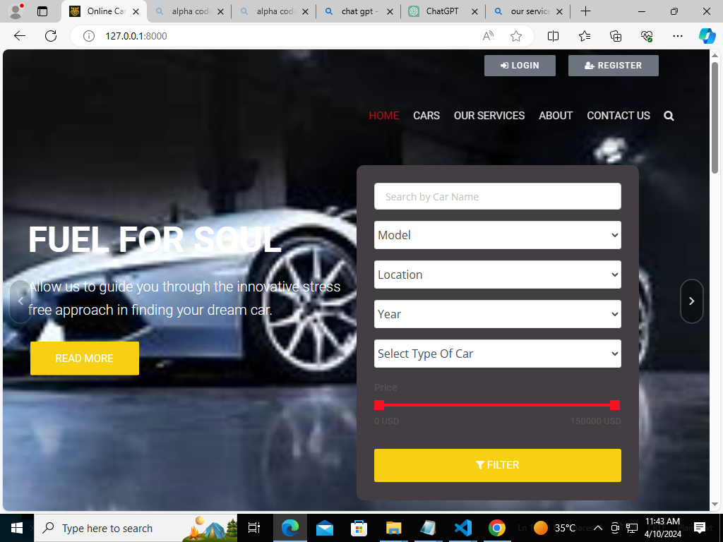
Homepage

Slide 12
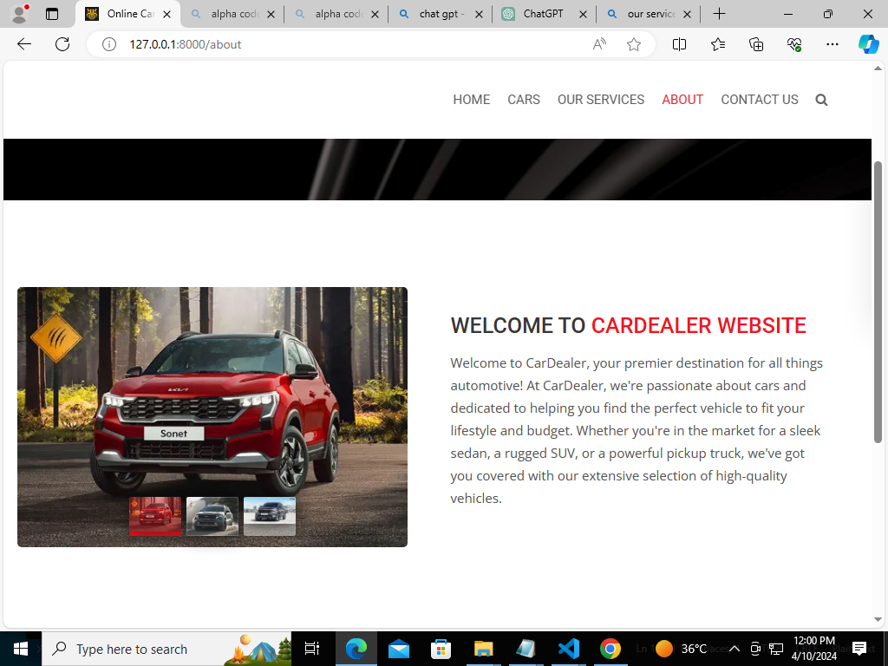
About-Us-Page

Slide 13
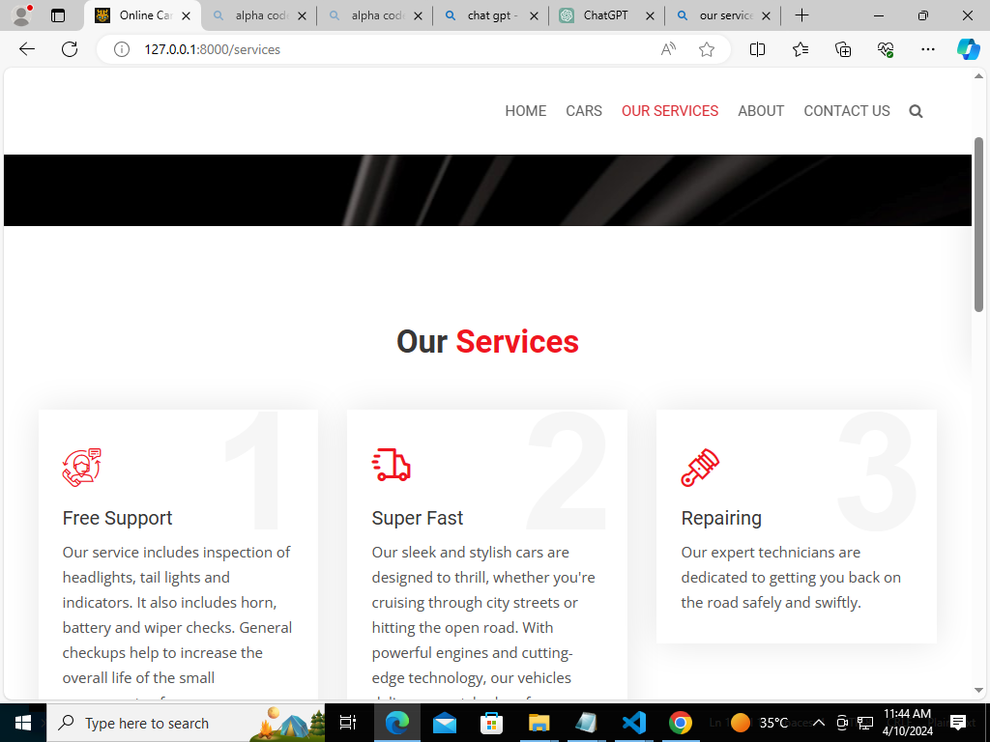
Service-Page

Slide 14
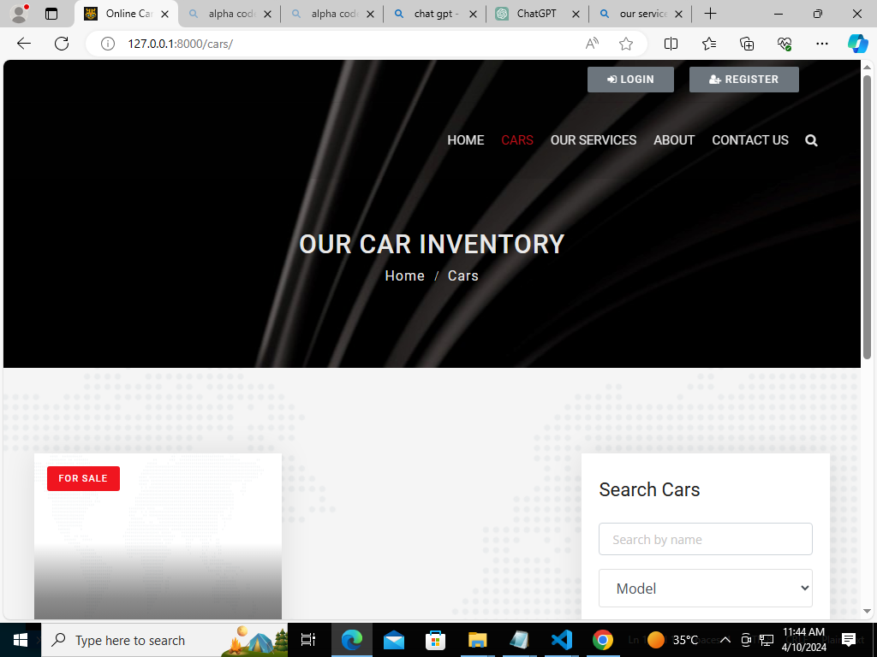
Cars-Page

Slide 15
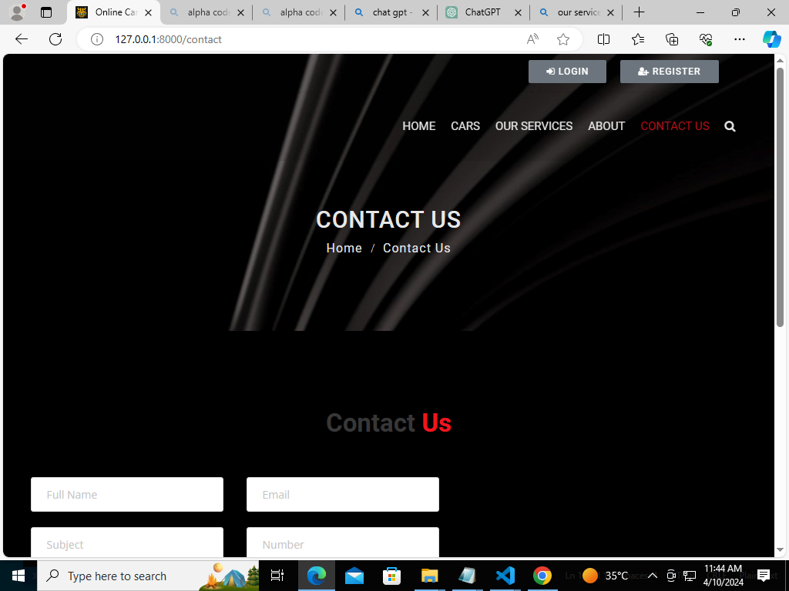
Blog-Page

Slide 16
Future Enhancements:
Electric and Sustainable Fleet Expansion:
With the growing focus on sustainability, car rental companies can invest more in electric and hybrid vehicles. This not only reduces carbon emissions but also aligns with the increasing demand for eco-friendly transportation options.
Autonomous Vehicles Integration:
As autonomous vehicle technology advances, integrating self-driving cars into rental fleets could become a reality. This would offer customers the convenience of hands-free driving and potentially lower costs for rental companies due to reduced labor expenses.

Slide 17
Conclusion
The future of car rentals is poised for significant evolution, driven by technological advancements, shifting consumer preferences, and a growing emphasis on sustainability and convenience. As the industry continues to adapt, several key trends and enhancements are likely to shape its trajectory.
Source :

Slide 18
Thank You!
Notes:
Thank You !!

